Slide 1
Morrisby Profile
Aptitudes assessment session

Slide 2
Procedure (Supervised session)
Check venue, timings, and environment
Ensure all devices are switched on and have access to a web browser
All other programs, browser tabs & windows should be closed
Deliver session introductions (See Admin Guide) simplified as:
Go to: www.morrisby.com
Click ‘Sign Up’.
Enter Registration Code: ********
Enter details and email address
Enter password & click Sign Up
Personal Details: EAL; SLDs; etc; Secondary email address option
Credentials confirmed by email
Continue
* For remote sessions, see guidelines for completing at home

Slide 3
What is involved
Open a browser, go to www.morrisby.com & click “SIGN UP”.

Slide 4
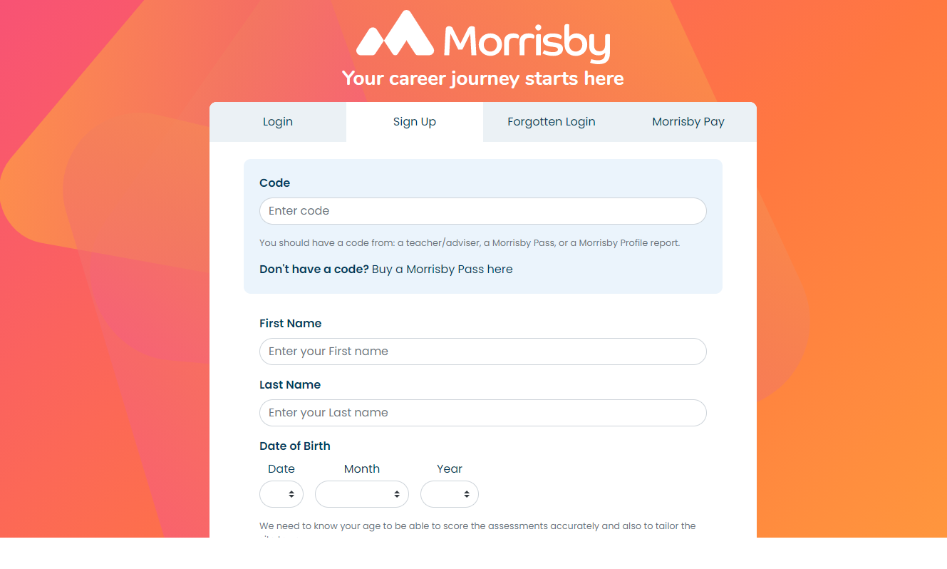

Slide 6
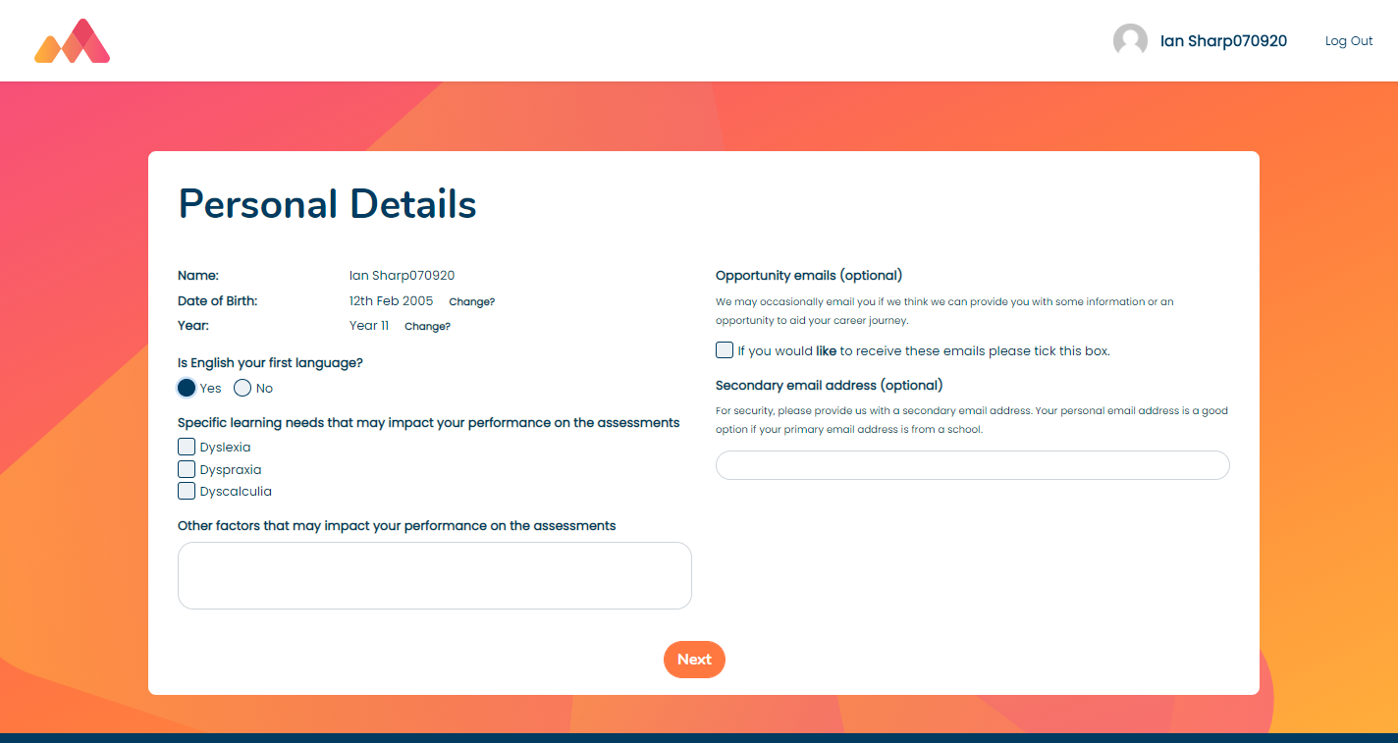

Slide 7
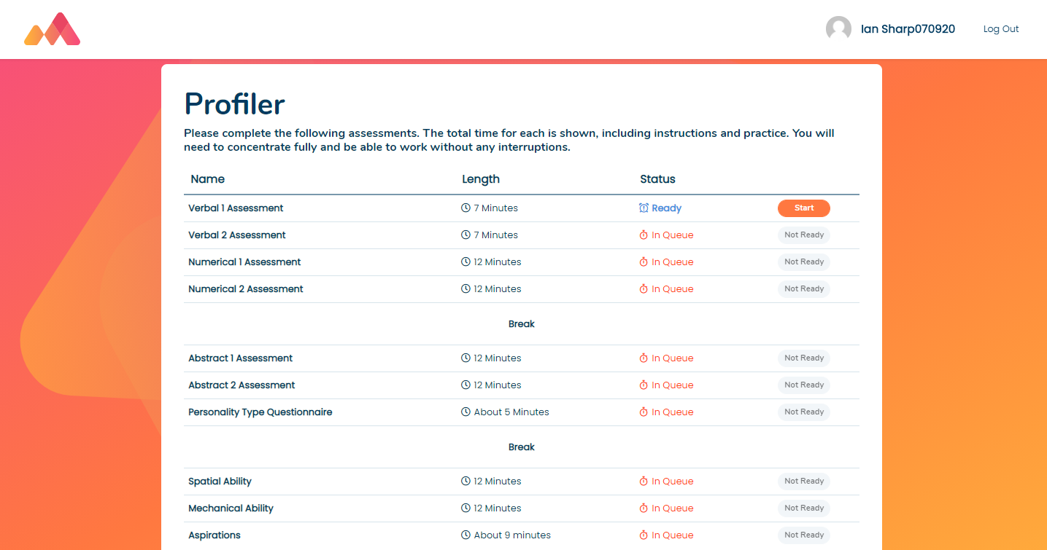

Slide 8
How should students approach the session?
The process (with full assessment ) will take about 100-120 minutes.
The accuracy of the results, and therefore the value they will be later, can be impacted by the approach taken. So...
Candidates must be able to work without being disturbed or distracted, so they can concentrate and do their best. i.e. exam conditions.
Important to not underestimate the Aptitude assessments (timed tests),
... although these tests may seem easy to begin with, that is their nature - they will get gradually more difficult.
Candidates are also not expected to finish the aptitude tests in the time allowed, nor can they skip to the next test if they finish with time remaining
So, it’s important they not rush, or start answering randomly just to get the end of any test – there is no benefit to doing so
NB. Other sections: practice questions & questionnaires are all untimed.

Slide 9
Australian and NZ support
Contacting the UK for support will lose you 10+ hours due to the time difference.
Always contact an Australian number for speedy support.
NSW only – Emma Goodsir - 02 9875 5150
QLD only – Katie Vevoda - 0417 758504
All Australia - Barry Darnell - 0405 812 113
Career Analysts support line: (03) 9752 6350

