Slide 1
Apprenticeships/ Traineeships
Amended 14 March 2023

Slide 2
Apprenticeship and traineeship levels
Traineeships – generally run at the Certificate II – III level
Apprenticeships in Skilled Trades – run at the Certificate III level
Advanced apprenticeships and traineeships – generally run at the Certificate IV (sometimes Diploma) level
* Advanced Apprenticeships can’t be entered without completing an apprenticeship first
* Certificate III is generally considered the vocational equivalent of Year 12.

Slide 3
Case studies
Jane is a student studying Year 12. Her subjects are English, Further Maths, Technology, IT and VET Engineering. She has become interested in mechanical engineering and realises she can’t get into many engineering degrees without Maths Methods and Physics, but her aim is to eventually study an engineering degree.
Visit AAP Pathways at
https://www.aapathways.com.au/career
-research/job-pathways
For salary information visit:
https://calculate.fairwork.gov.au/
Choose one apprenticeship or traineeship your case study student could apply for
What level apprenticeship/traineeship is it?
What are the entry requirements?
What Certificate qualification and key skills will they learn?
How much will they earn?
Where can they progress after they gain this qualification? How?
Sam is currently in Year 11. He will turn 17 in November. He is studying English, General Maths, Psychology, Business Studies, Health and VET Community Services. He has recently done some work experience in a care home and would like a career in social care. He doesn’t want to do Year 12, but is keen to enter the workplace.

Slide 4
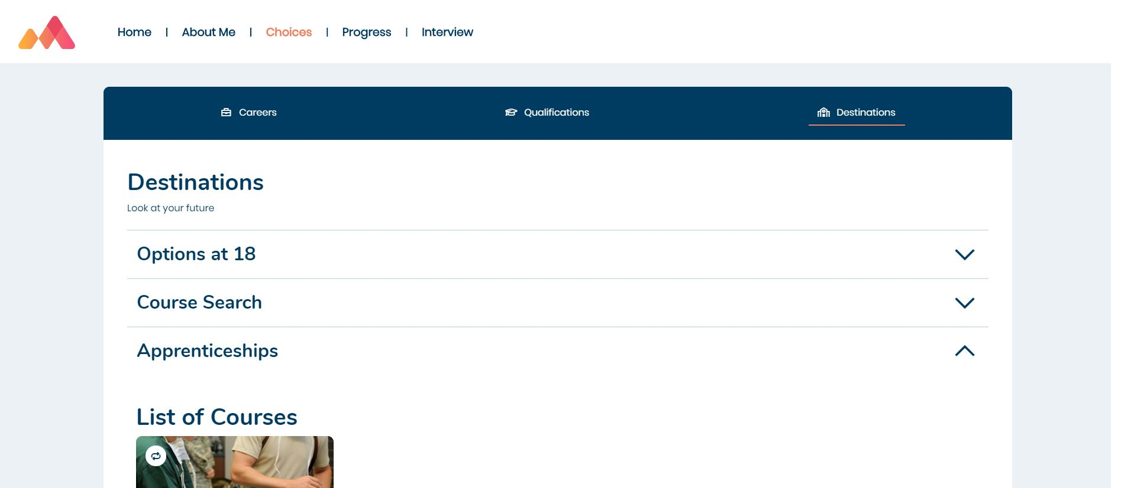
Apprenticeships on Morrisby
Click on a suggested subject tile to find out more about the apprenticeship
www.morrisby.com > Login
In your Choices area
Visit your Destinations area

