Slide 1
Challenging workplace stereotypes
Amended 14 March 2023

Slide 2
Choose your apprentice
You are an entrepreneur, like one of the judges on The Apprentice
You need to ‘hire’ an engineer to set up life on the moon!
It’s a big, challenging job that will make history
It needs the right apprentice - someone with resilience, determination, engineering expertise and great people skills!
The activities in this lesson are used with the permission of the Equality and Human Rights Commission https://equalityhumanrights.com/

Slide 3
Choose your apprentice
Line up the cards in front of you - that is your apprentice line up
Each time I reveal a layer of information about each apprentice, you need to ‘fire’ one person by removing them from your line up
Who will you ‘fire’ and ‘hire’?

Slide 4
Choose your apprentice
The apprentices…
Fire one now so you have six remaining
Ali
Patrick
Jamie
David
Adriana
Hannah
Delroy

Slide 5
Choose your apprentice
Fire one now so you have five remaining
Ali Abdul
Patrick Murphy
Jamie Small
David Campbell
Adriana Carboni
Hannah Mann
Delroy Bailey

Slide 6
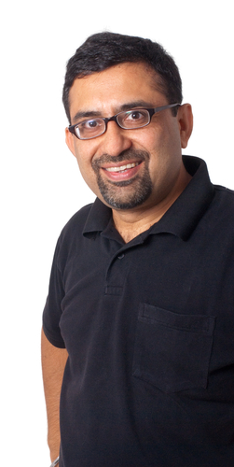
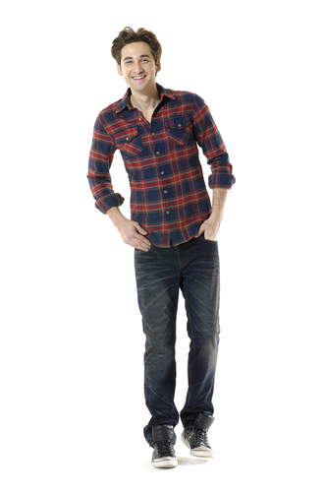
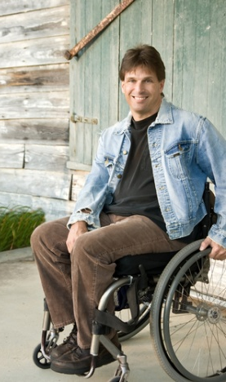
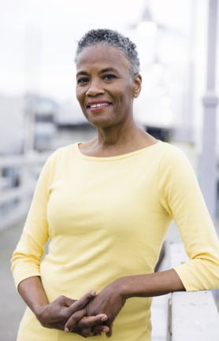
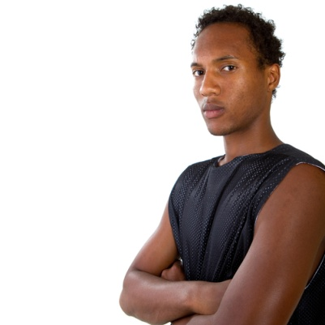
Choose your apprentice
Fire one so you now have four remaining
Ali Abdul
Patrick Murphy
Jamie Small
David Campbell
Adriana Carboni
Hannah Mann
Delroy Bailey

Slide 7
Choose your apprentice
Fire one so you now have three remaining
Ali Abdul
Patrick Murphy
Jamie Small
David Campbell
Adriana Carboni
Hannah Mann
Delroy Bailey
Hetero- sexual
Gay
Lesbian
Hetero- sexual
Hetero- sexual
Hetero- sexual
Hetero- sexual

Slide 8
Choose your apprentice
Fire one so you now have two remaining
Ali Abdul
Patrick Murphy
Jamie Small
David Campbell
Adriana Carboni
Hannah Mann
Delroy Bailey
Physically fit but wears glasses
Physically and mentally fit
Physically and mentally
fit
Physically disabled and mentally fit
Physically and mentally fit
Pregnant, physically and mentally fit
Physically fit but suffers with anxiety

Slide 9
Choose your apprentice
Fire one so you now have one remaining
Ali Abdul
Patrick Murphy
Jamie Small
David Campbell
Adriana Carboni
Hannah Mann
Delroy Bailey
Ex-Army
Entrepren-eur / business man
Firewoman
Doctor of engineer-
ing
Engineer and project manager
Army engineering officer
Engineer graduate

Slide 10
Who was your choice?
What choice did you make?
Are you pleased with your hired apprentice?
Would you have made a different decision if you had the qualifications information first?
What is wrong with judging people with such little information?
What do you think influenced your decisions?
Do you think people often judge people like this in our everyday life?
What could be the consequences of pre-judging people?

Slide 11
Stereotypes and prejudice
It is wrong to judge people based on their identity and can have negative consequences
This lesson has explored stereotypes and prejudice
Outcomes so far are:
Highlighting to you that some people have negative attitudes and what is meant by prejudice and stereotypes
You should be able to recognise your own and others stereotypical and prejudicial attitudes
You should be aware of the negative consequences of prejudice and stereotypes

Slide 12
Stereotypes and prejudice
How would you define or explain stereotypes and prejudice?
Stereotypes: thinking all people who belong to a certain group are the same and labelling them; for example all young people who wear hoodies are thugs
Prejudice: judging someone without knowing them, on the basis of what they look like or what group they belong to; for example all black people are good dancers

Slide 13
Labelling teenagers
Consider:
How do you think adults, society and the media label teenagers?
Do different groups of young people get labelled in different ways?
What prejudiced attitudes or behaviour could this lead to?
Working in pairs:
Create a stereotypical image of teenagers or a group of young people
Decide whether this is fair or not
Explain the consequences of this label

Slide 14
Labelling teenagers
What labels/images did you create?
Do you think these labels/images are true or fair?
Could they lead to any problems?

Slide 15
Challenging stereotypes
Working in pairs, review the statements on the following slide which are all stereotypes
Take it in turns to role-play:
one person says the statement to their partner
the other person acts in role of the stereotyped group and says:
how the statement makes them feel
why it isn’t true or fair to label all people like that
Choose five statements each
Students will be selected to present their conversation to peers

Slide 16
Challenging stereotypes
Statements:
All gay men are weird
The woman’s place is in the home
All black people are good at sports
You have to talk slowly to a disabled person
All kids are lazy
Blonde women are stupid
Elderly people are frail and boring
Boys in hoodies are violent
Immigrants are scroungers
All gypsies are thieves
Boys that cry are gay

