Slide 1
Morrisby Careers
Aspirations assessment session

Slide 2
Open a browser, go to www.morrisby.com & click “SIGN UP”

Slide 3
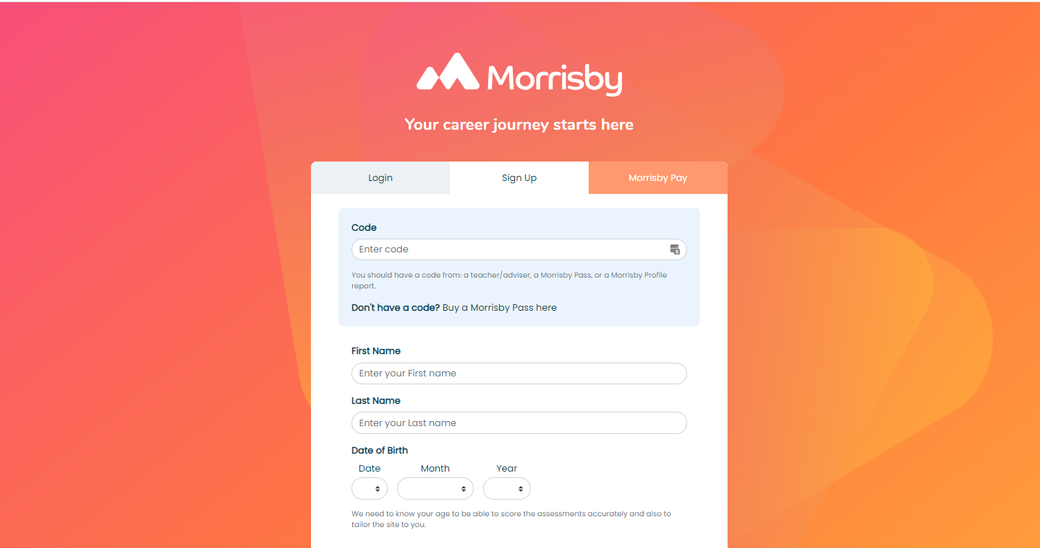

Slide 5
How should you approach it?
The process will take about 15 minutes
It is important to be honest in answering the questions
Make sure your answers are based on your own interests and not on what you think you should be answering
Although the questionnaire is untimed, don’t take too long on each question - just answer with the first thing that comes into your head as this is usually the most accurate answer
If your interests change in the future you can retake the questionnaire
Your results will include a number of careers that best match your interests

Slide 6
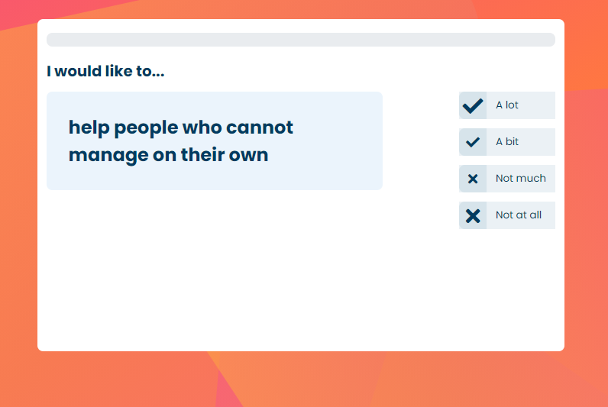
The Aspirations questionnaire

Slide 7
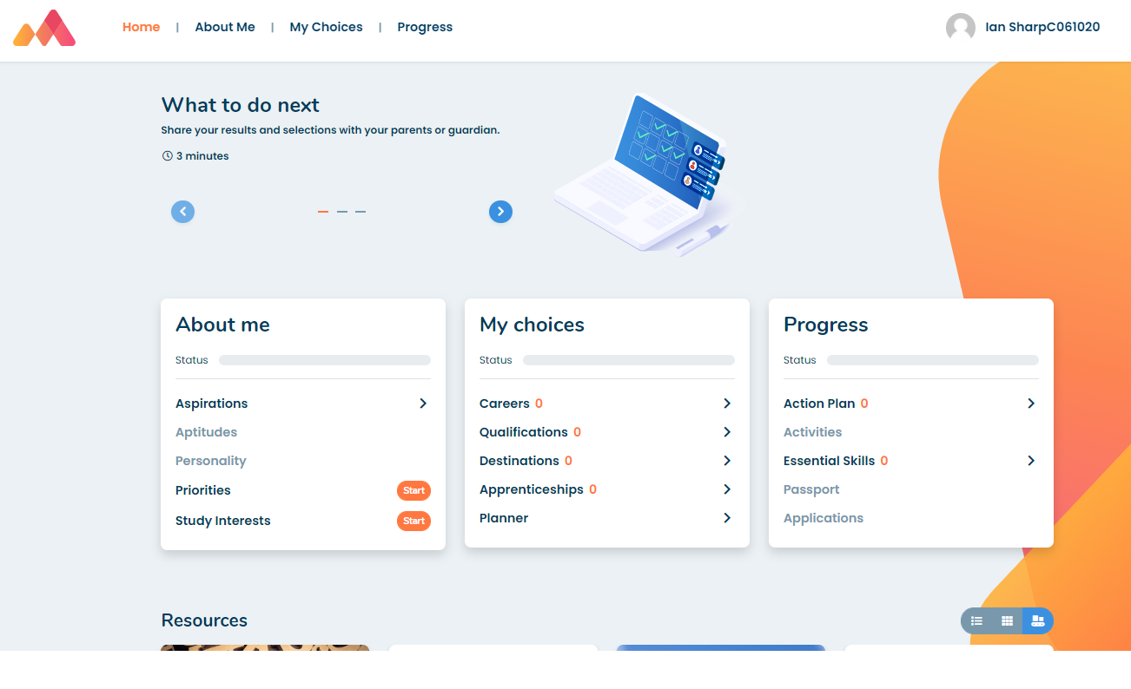
Dashboard / Home > Select Aspirations

Slide 8
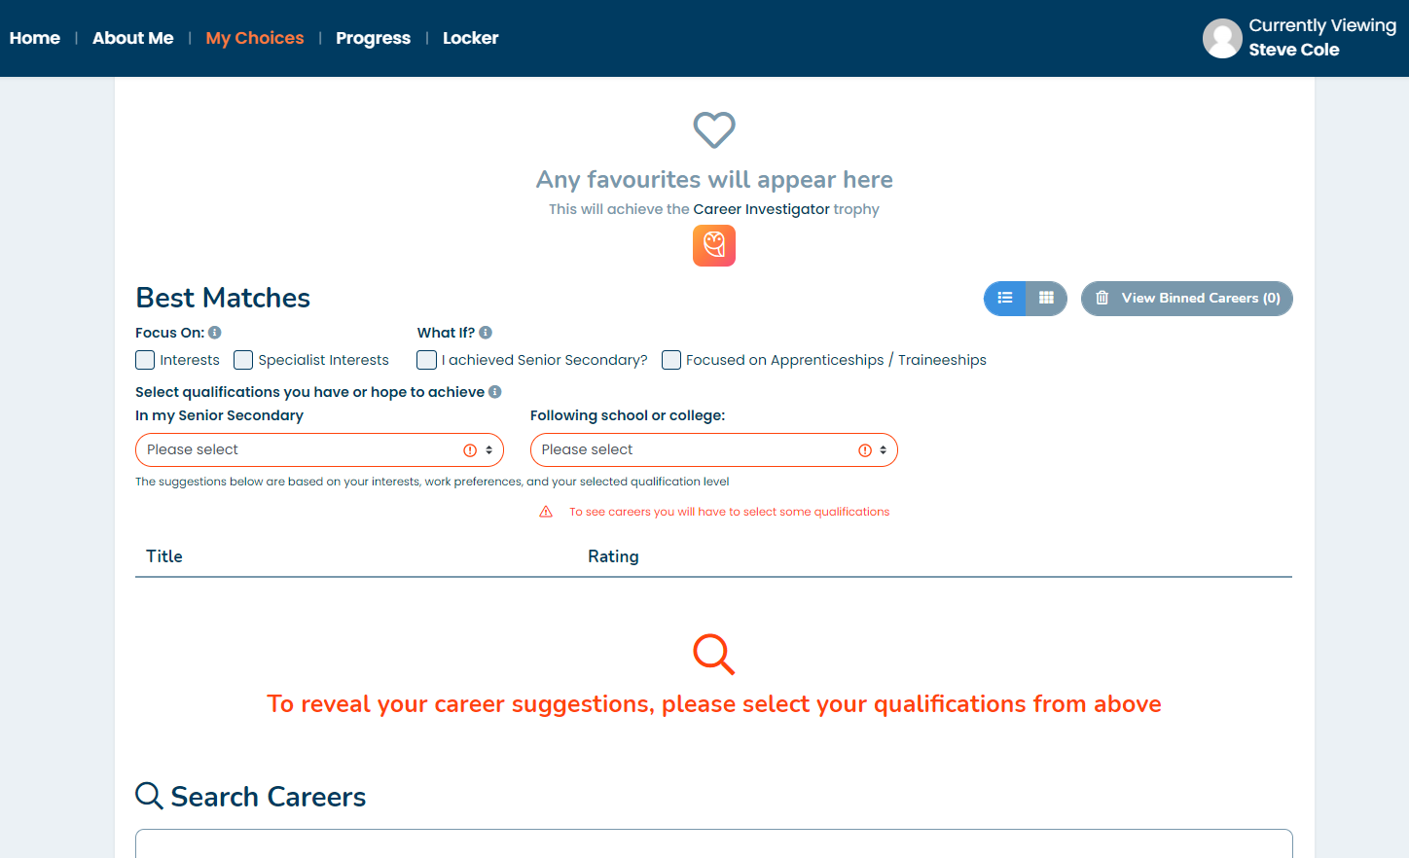
Set qualification levels to view suggestions…

Slide 9
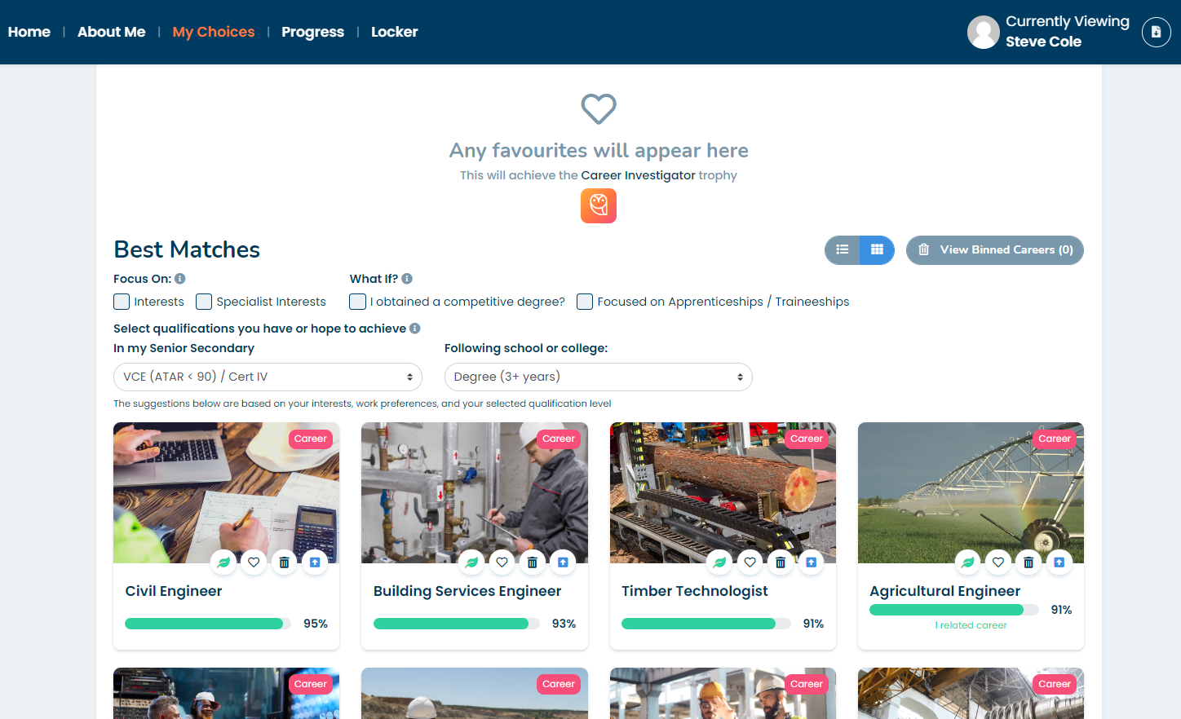
Start researching Careers!

